Slide 1


Molecular Characterization of β-Lactamase and Carbapenemase-Producing Enterobacterales in Children Under Five in Kibera, Nairobi Kenya.
Head Shot
Beatrice Oduor, BSc, MSc
Association of Public Health Laboratories-Kenya

Slide 2
Background
Antimicrobial resistance (AR) is a global crisis, expected to cause 10 million deaths per year by 2050.
In Kenya, AR was responsible for >8,000 deaths and associated with >28,000 deaths in 2019.
Surveillance for AR is critical for tracking population-level resistance trends and guiding effective prevention strategies.

Slide 3
Study Aim and Objectives
Aim
To incorporate phenotypic and genotypic AR surveillance into Kenya’s Population-Based Integrated Disease Surveillance (PBIDS) platform.
Objectives
To determine colonization prevalence of extended-spectrum cephalosporin-resistant Enterobacterales (ESCrE) and carbapenem-resistant Enterobacterales (CRE) among children under five years of age.
To characterize extended-spectrum β-lactamase (ESBL) and carbapenemase genes detected among ESCrE and CRE isolates and determine their frequency.

Slide 4
Study Design and Population
Study design: Cross-sectional study.
Study population: Children <5 years who presented to Tabitha Clinic
in Gatwekera Kibera, it is part of Kenya’s PBIDS platforms.
Inclusion criteria: All children under 5 years whose guardian/parent consented.
Sample size: 120
Demographic data: Age and gender
Enrollment and sample collection: May 2025
Sample: Rectal Swabs

Slide 5
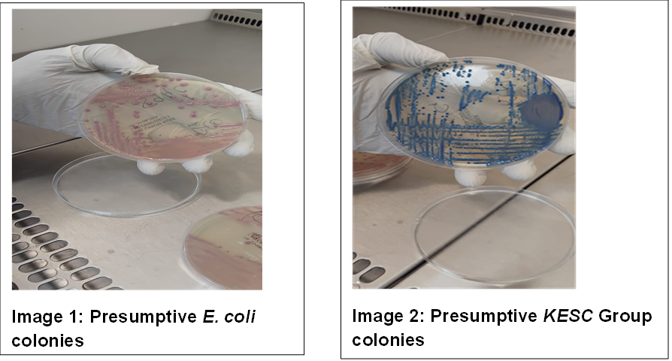
Methodology
Culture
The rectal samples were cultured on MacConkey agar plates, Chrom™ ESBL and CHROMagar™ mSuperCARBA™ agar plates, 37 °C for 18–24 hours.
Up to three pink and bluish colonies with different morphologies from the Chrom plates were selected as presumptively Escherichia coli (pink colonies) from the ESBL and CRE plates. Bluish colonies, presumptively Klebsiella spp., Enterobacter spp., Serratia spp., or Citrobacter spp (KESC).

Slide 6
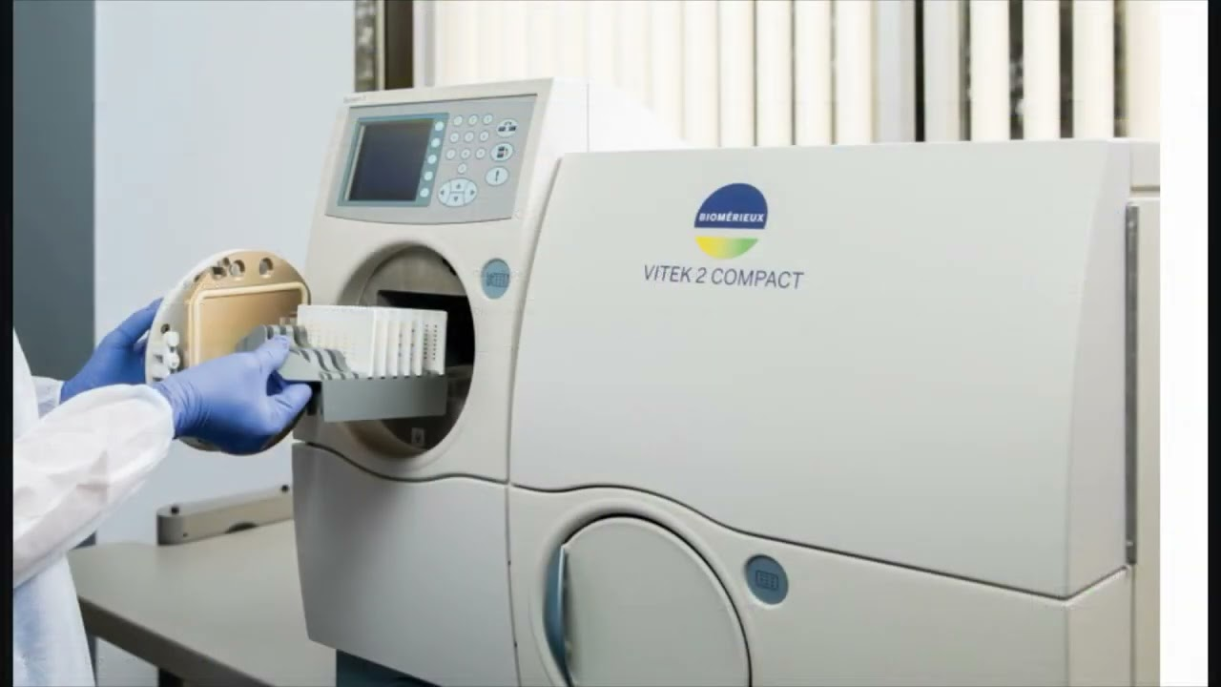
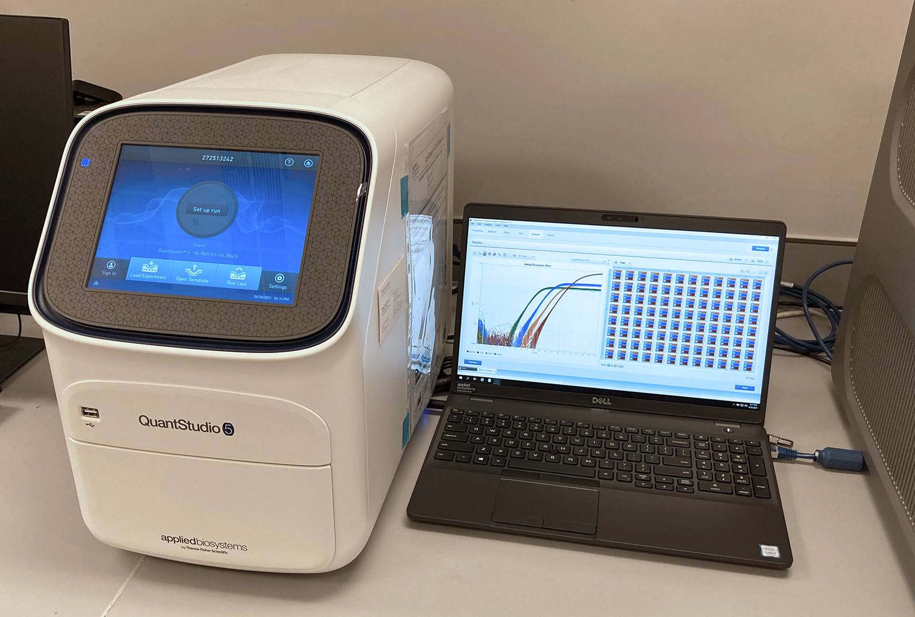
Methodology
Identification and Susceptibility testing
Confirmatory identification and antibiotic susceptibility testing on Vitek 2 system, using GN ID and AST GN 86 cards.
DNA extraction : Extraction using Qiagen DNeasy UltraClean Tissue Kit.
Detection of genes using PCR
ESBL, ampC and carbapenemase genes using Quant studio-5 PCR equipment and Streck ARM D® β-Lactamase (RUO) Kit.
The kit detects 9 β-lactamase gene families: CMY-2, CTX-M-15, CTX-M-14, OXA-48, IMP, VIM, DHA, KPC, and NDM.
Vitek 2
Quant Studio-5

Slide 7
Results and Discussion
Among 120 children enrolled, 72% (86/120) were colonized with ESCrE and 4% (5/120) were colonized with CRE.
Of the children colonized with ESCrE, 99% (85/86) were colonized with ESBL-producing Enterobacterales based on gene detection.
bla_{CTX-M-15,}was detected in 82% (70/85) of colonized children and bla_{CTX-M-14} was detected in 22% (19/85); bla_{CMY-2} was not detected.

Slide 8
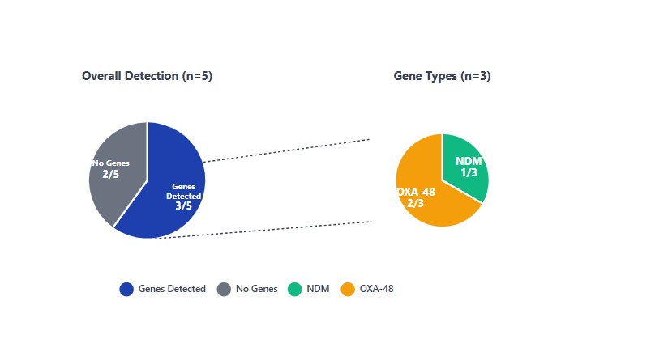
Results and Discussion
Frequency of Carbapenemase genes among children colonized with Carbapenemase-producing Enterobacterales.
Among the children colonized with CRE, 60% (3/5) were colonized with carbapenemase genes, with bla_{NDM} detected in 1 child and bla_{OXA-48} in 2 children.

Slide 9
Conclusion
Colonization screening for AR can be effectively integrated into existing surveillance platforms, offering valuable insights into the molecular epidemiology of resistant Gram-negative bacteria.
The high prevalence of ESBL-producing ESCrE in outpatient settings points to ongoing community transmission and highlights the need for targeted public health interventions.
In contrast, the low prevalence of carbapenemase-producing CRE suggests a more recent emergence, reinforcing the critical role of genotypic data in guiding timely response and containment strategies.

Slide 10

Acknowledgment
Collaborators
Association of Public Health Laboratories-Kenya (APHL)
Washington State University Global Health-Kenya (WSU GH-K)
Kenya Medical Research Institute (KEMRI)
CDC Headquarters-Atlanta USA
CDC Kenya Country Office
Funding Source: The Applied Science Hub Antimicrobial Resistance (ASH-AMR) project is supported by Cooperative Agreement #NU2HGH 000032 from the US Centers for Disease Control and Prevention (CDC).

Slide 11
Thank you!

